Slide 1

OYO – Room Sales Analysis (2017)

Slide 2
Case Study
This Case study consist of 2 data sets.
The first dataset consists of hotel booking details of various customers in different cities.
The second dataset contains the hotel ID and the city where it is located.

Slide 3
Important factors to optimize Business
Average room rates of different cities
No. of hotels in different cities.
Cancellation rate.
Discount offered.
No. of bookings in given time period.
Revenue.

Slide 4
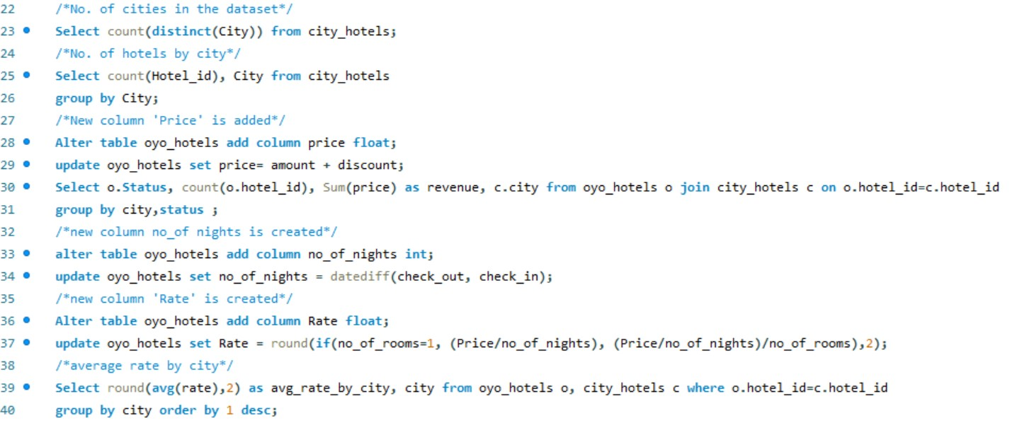
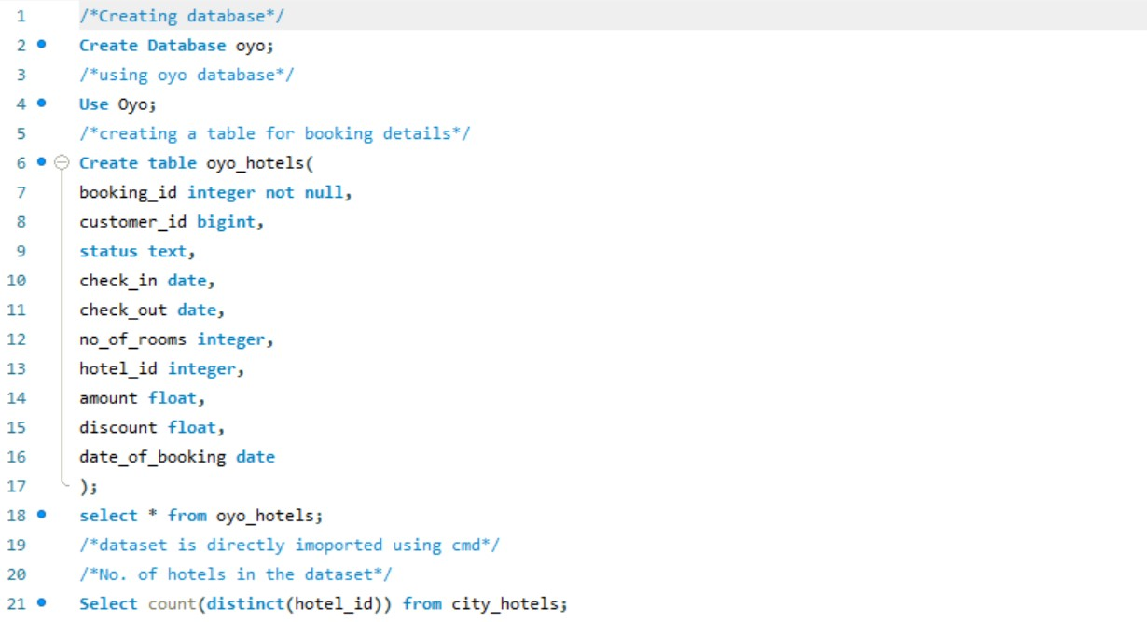
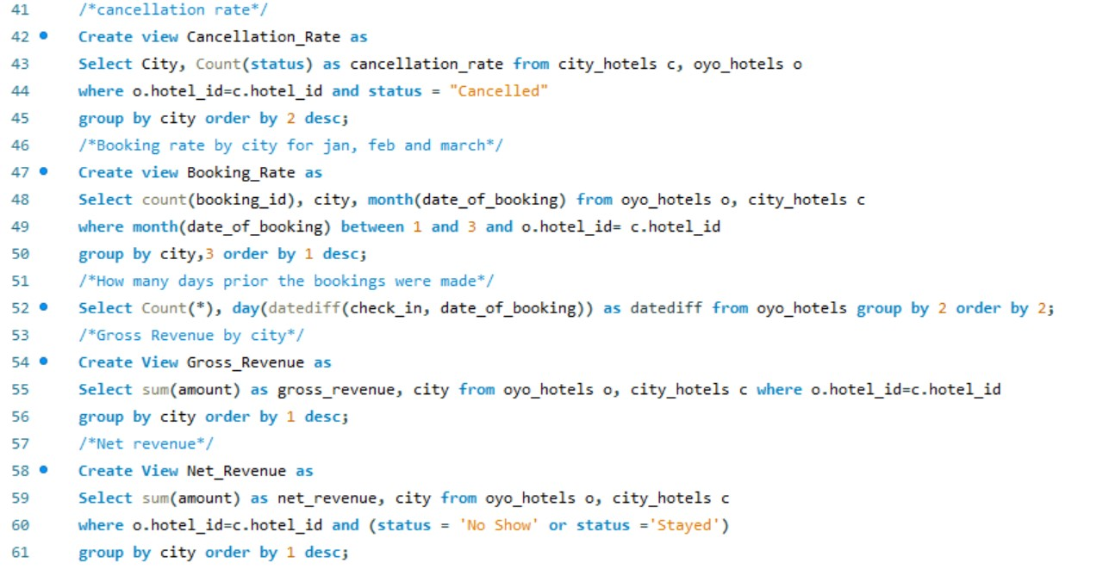
SQL Queries

Slide 5
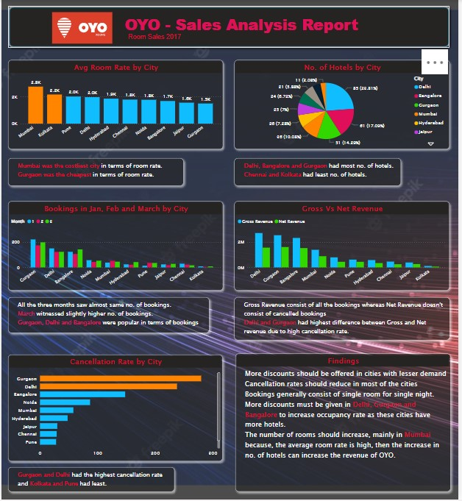
Power BI Report

